Slide 1
Global Development Index
K-Means Clustering
Analysis & Clustering
PCA Dimensionality Reduction
Machine Learning Project | Unsupervised Learning
Streamlit Deployment
Presented by: Mihir Nigam

Slide 2
Project Overview
Business Objective & Dataset Summary
Business Objective
Dataset Overview
Build an unsupervised machine learning pipeline to cluster countries
based on global development metrics, enabling data-driven comparisons
of economic and social progress across nations worldwide.
Source: World_development_measurement.csv
Size: 2,704 rows × 25 columns
Coverage: Country-level economic & demographic indicators
Time span: Multiple years of global measurement data
Key Variables
Birth Rate, Business Tax Rate, CO2 Emissions, Days to Start Business, Ease of Business,
Energy Usage, GDP, Health Exp % GDP, Health Exp/Capita, Hours to do Tax, Infant Mortality,
Internet Usage, Lending Interest, Life Expectancy (M/F), Mobile Usage, Population (0–14,
15–64, 65+, Total, Urban), Tourism Inbound, Tourism Outbound
Acceptance Criteria
Comparative analysis of multiple clustering models • Deployment via Streamlit / Flask
2 / 22

Slide 3
Technology Stack
Tools & Libraries Used
Python
Pandas
NumPy
Scikit-Learn
Matplotlib
Core programming language
Data manipulation & analysis
Numerical computing
ML algorithms & preprocessing
Static data visualization
Seaborn
Streamlit
Git / VSCode
Statistical visualizations
Web app deployment
Version control & IDE
3 / 22

Slide 4
Problem Definition
Motivation & Expected Outcomes
Problem Overview
🌐 Developed Nations
Nations differ vastly in economic strength, healthcare infrastructure,
technology penetration, and demographic composition. This project applies
unsupervised machine learning to detect hidden patterns in these indicators
and group countries into meaningful development-level clusters — providing
actionable insights for policymakers, researchers, and global organisations.
📈 Emerging Economies
🔧 Developing Nations
⚠️ Underdeveloped Nations
Research Questions
• Which socioeconomic features most strongly differentiate development levels?
• How many natural clusters exist in global development data?
• Which clustering algorithm best captures the underlying data structure?
4 / 22

Slide 5
Dataset Details
Features & Classification
2,704
25
4
20
Total Records
Original Features
Target Clusters
Features After Cleaning
Feature List (25 Variables)
'Birth Rate', 'Business Tax Rate', 'CO2 Emissions', 'Country', 'Days to Start Business',
'Ease of Business', 'Energy Usage', 'GDP', 'Health Exp % GDP', 'Health Exp/Capita',
'Hours to do Tax', 'Infant Mortality Rate', 'Internet Usage', 'Lending Interest',
'Life Expectancy Female', 'Life Expectancy Male', 'Mobile Phone Usage', 'Number of Records',
'Population 0-14', 'Population 15-64', 'Population 65+', 'Population Total', 'Population Urban',
'Tourism Inbound', 'Tourism Outbound'
1. Developed Countries
2. Developing Countries
3. Emerging Economies
4. Underdeveloped Countries
5 / 22

Slide 6
Exploratory Data Analysis (EDA)
Data Cleaning & Null Value Handling
🔍 Data Inspection
🗑️ Missing Value Strategy
▸ Identified data types across all 25 columns
▸ Detected and flagged mixed-format values
▸ Removed special characters (%, $) to enable numeric parsing
▸ Dropped columns with >35% missing values
▸ Imputed remaining nulls using column mean or median
▸ Validated imputation did not skew distributions
📉 Zero-Variance Removal
🔄 Duplicate Handling
▸ Identified columns with no variability
▸ Removed zero-variance features as they carry no information
▸ Verified remaining features had meaningful spread
▸ Scanned dataset for duplicate rows
▸ Removed confirmed duplicates to prevent data leakage
▸ Final clean dataset retained for EDA & modeling
6 / 22

Slide 7
Exploratory Data Analysis (EDA)
Outlier Detection & Correlation Analysis
Outlier Detection
Outlier Treatment
Correlation Analysis
Identified extreme values using box plots
Extreme outliers bias model performance
and lead to skewed cluster assignments
Flagged features with heavy right-skew
Applied IQR (Interquartile Range) capping
Values below Q1–1.5×IQR capped to lower bound
Values above Q3+1.5×IQR capped to upper bound
Preserved data volume while reducing extremes
Computed Pearson correlation matrix
Identified strong positive & negative pairs
Diagonal ignored (self-correlation = 1.0)
High collinearity guided PCA feature selection
Key Correlation Findings
Birth Rate ↔ Infant Mortality
+0.87
Birth Rate ↔ Life Expectancy F
–0.87
GDP ↔ Tourism Outbound
+0.93
Internet Usage ↔ Health/Capita
+0.77
7 / 22

Slide 8
Data Preprocessing
Scaling, Encoding & Transformation Techniques
Min-Max Normalization
Rescales all feature values to the fixed range [0, 1] while preserving relative relationships between data points.
Z-Score Standardization
Transforms features to zero mean and unit variance using (x − μ) / σ. Robust to outlier influence.
Log Transformation
Applies log(x+1) to reduce right-skewness in heavily skewed economic distributions like GDP and CO2.
One-Hot Encoding
Converts nominal categorical variables into binary indicator columns to avoid ordinal assumptions.
Label Encoding
Maps each categorical class to an integer. Used for the Country feature in this project pipeline.
✅ StandardScaler was applied in this project — values normalized to range [–3, +3]
8 / 22

Slide 9
Correlation Matrix
Pairwise Correlation of Key Features
Feature
Birth Rate
CO2 Emiss.
Energy
GDP
Health/Cap
Infant Mort.
Internet
Life Exp F
Mobile
Birth Rate
1.00
-0.35
-0.28
-0.41
-0.59
0.87
-0.62
-0.87
-0.54
CO2 Emissions
-0.35
1.00
0.83
0.73
0.32
-0.30
0.19
0.31
0.14
Energy Usage
-0.28
0.83
1.00
0.80
0.34
-0.22
0.28
0.26
0.20
GDP
-0.41
0.73
0.80
1.00
0.56
-0.39
0.49
0.42
0.41
Health/Capita
-0.59
0.32
0.34
0.56
1.00
-0.61
0.77
0.59
0.58
Infant Mort.
0.87
-0.30
-0.22
-0.39
-0.61
1.00
-0.62
-0.92
-0.57
Internet Usage
-0.62
0.19
0.28
0.49
0.77
-0.62
1.00
0.64
0.74
Life Exp F
-0.87
0.31
0.26
0.42
0.59
-0.92
0.64
1.00
0.55
Color key:
9 / 22

Slide 10
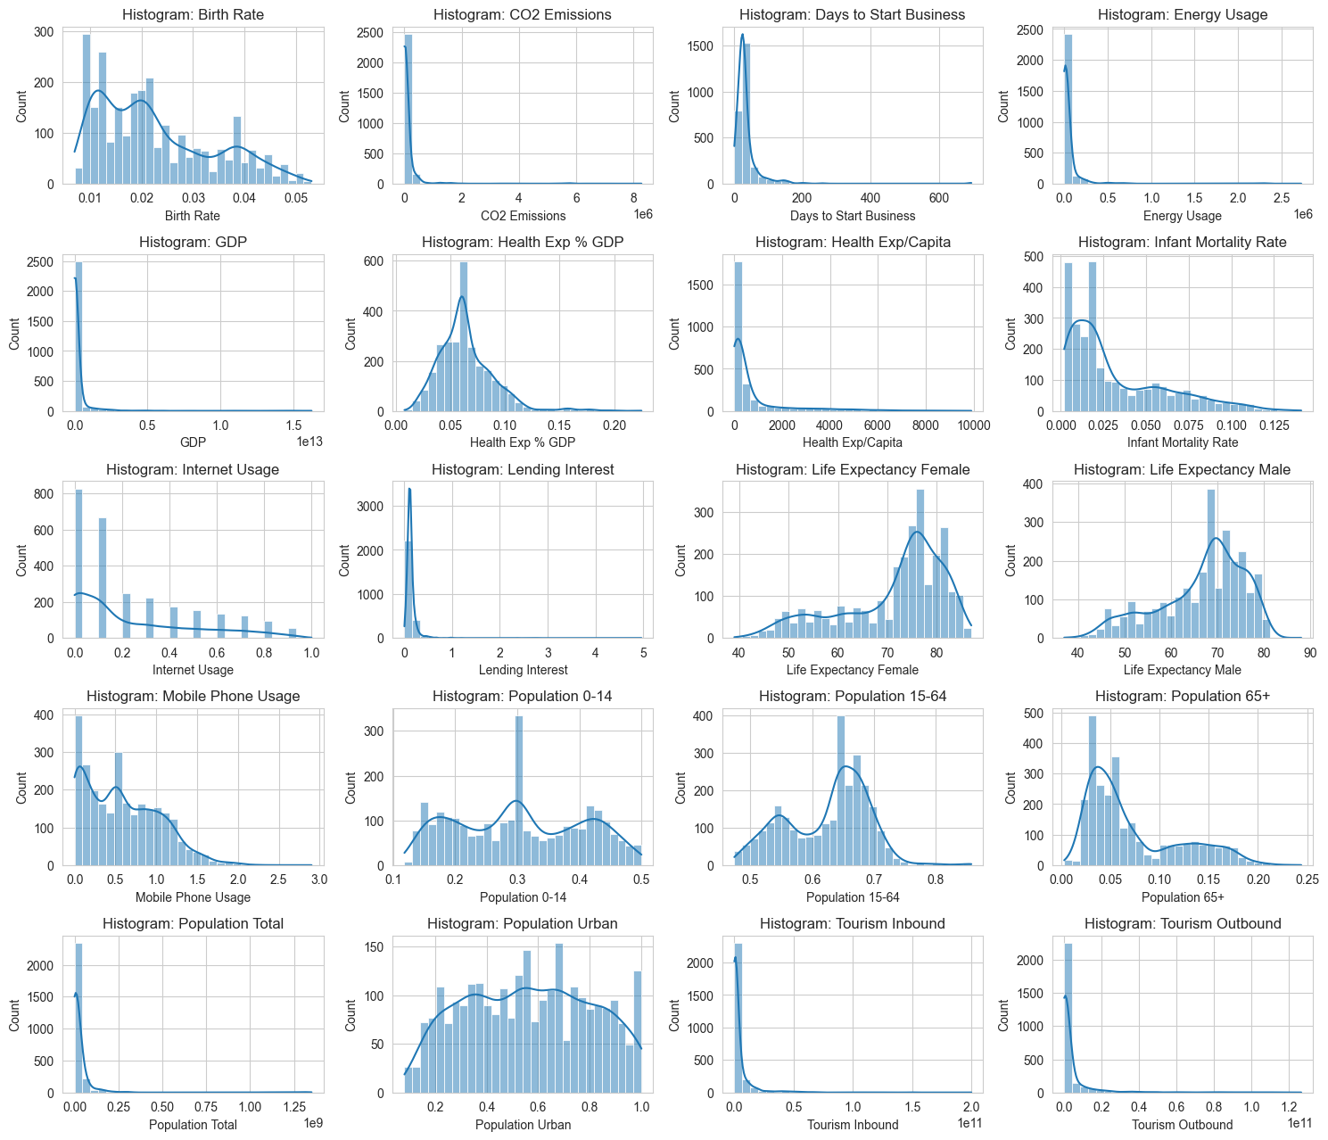
Feature Distribution Analysis
Histograms of All 20 Numeric Features
Most features exhibit right-skewed distributions — especially GDP, CO2, Population Total & Tourism metrics. Log transformation was applied to reduce skewness before modeling.
10 / 22

Slide 11
Feature Scaling
Standardization Techniques Applied to the Dataset
Data preprocessing is a critical step in any ML pipeline. Raw features often come with different units, scales, and distributions — this causes distance-based algorithms like K-Means to be dominated by high-magnitude features. Feature scaling ensures each variable contributes equally to the model.
StandardScaler (Used in Project)
MinMaxScaler (Alternative)
Centers data to μ = 0, σ = 1 via (x − μ) / σ
Output range: approximately –3 to +3
Best for normally distributed features
Robust for algorithms sensitive to magnitude
Rescales to fixed range [0, 1] via (x − min)/(max − min)
Sensitive to outliers — extreme values compress others
Useful when a bounded range is required
Often combined with outlier capping
StandardScaler Output Range
–3
0 (mean)
+3
11 / 22

Slide 12
Scaled Data Preview
First 5 Rows After StandardScaler Transformation
Idx
Birth Rate
CO2 Emiss.
Days/Bus.
Energy
GDP
Hlth%GDP
Hlth/Cap
Inf.Mort.
Internet
Lending
0
-0.23
1.66
-0.15
0.59
-0.06
-1.27
-0.75
0.09
-0.91
-0.53
1
2.47
-0.49
-0.15
-0.73
-0.62
-1.31
-0.83
2.70
-0.91
2.07
2
1.84
-0.70
-0.15
-1.10
-0.70
-0.90
-0.85
2.08
-0.91
-0.12
3
0.40
-0.63
-0.15
-1.11
-0.66
-0.72
-0.54
0.80
-0.91
0.60
4
2.11
-0.72
-0.15
-0.27
-0.70
-0.54
-0.85
2.29
-0.91
-0.12
⚡ Highlighted values indicate |z| ≥ 1.0 (moderate) or |z| ≥ 2.0 (high deviation) from the mean
12 / 22

Slide 13
Principal Component Analysis (PCA)
Dimensionality Reduction Technique
PCA transforms correlated high-dimensional features into a smaller set of uncorrelated principal components, retaining the directions of maximum variance. This project used PCA to reduce 20 features to 6 components while preserving 95% of the total data variance.
Reduces Dimensionality
Cuts Compute Cost
Removes Noise
📉
Transforms 20 correlated features into 6 independent principal components.
⚡
Fewer features means faster training, lower memory usage, and quicker inference.
🎯
Focuses model on dominant variance patterns; discards low-information directions.
Enables Visualization
Prevents Overfitting
📊
Projects data to 2D/3D for human-interpretable scatter plots of clusters.
🤖
Eliminates redundant correlated features that could confuse model learning.
13 / 22

Slide 14
Feature Selection via PCA
Component Selection & Variance Explained
25
5
20
6
4
→
→
→
→
Original Features
Dropped in Cleaning
After Cleaning
Selected (95% var.)
Optimal Clusters
Covariance Matrix Selection: Tied covariance, 4 clusters, Best Silhouette Score = 0.353
Idx
PC1
PC2
PC3
PC4
PC5
PC6
PC7
PC8
PC9
PC10
0
0.84
1.33
-2.15
-0.19
-0.94
-0.60
0.94
-0.42
-0.77
0.21
1
5.98
1.68
1.13
-0.45
-0.44
1.28
-0.50
-0.92
0.65
0.85
2
4.66
0.48
0.72
-1.08
-0.03
-0.30
0.52
-0.66
0.65
0.14
3
3.52
-0.22
0.21
-0.25
-0.19
0.44
0.01
-1.44
0.55
0.07
4
5.12
1.30
1.21
-1.03
-0.10
-0.80
0.06
-0.59
0.19
0.33
14 / 22

Slide 15
Model Building Methods
Clustering Algorithms — Part 1 of 2
1. Partitioning Clustering
K-Means Clustering
Assigns each point to the nearest centroid. Minimises within-cluster sum of squares (inertia). Optimal K determined via Elbow Method.
K-Medoids Clustering
Uses actual data points as cluster centres (medoids). More robust to outliers than K-Means.
2. Hierarchical Clustering
Agglomerative Clustering
Bottom-up approach — merges the two closest clusters iteratively. Dendrogram used to visualise hierarchy.
Divisive Clustering
Top-down approach — recursively splits one large cluster. Computationally intensive for large datasets.
3. Density-Based Clustering
DBSCAN Algorithm
Groups points in dense regions; labels sparse points as noise (–1). Does not require specifying K in advance.
15 / 22

Slide 16
Model Building Methods
Clustering Algorithms — Part 2 of 2
4. Model-Based Clustering
Gaussian Mixture Models (GMM)
Probabilistic model assuming data is generated from a mixture of Gaussian distributions. Each cluster has its own mean and covariance. Uses Expectation–Maximisation (EM) algorithm.
5. Fuzzy Clustering
Fuzzy C-Means (FCM)
Each data point belongs to multiple clusters with a membership degree between 0 and 1. Useful for overlapping, ambiguous cluster boundaries. Minimises weighted sum of squared distances.
Algorithm Comparison Summary
Algorithm
Requires K?
Handles Noise?
Cluster Shape
Best For
K-Means
Yes
No
Spherical
Large balanced datasets
DBSCAN
No
Yes
Arbitrary
Noise-heavy spatial data
Agglomerative
Post-hoc
No
Hierarchical
Small-medium datasets
GMM
Yes
Partial
Elliptical
Probabilistic assignment
Fuzzy C-Means
Yes
No
Overlapping
Soft cluster boundaries
16 / 22

Slide 17
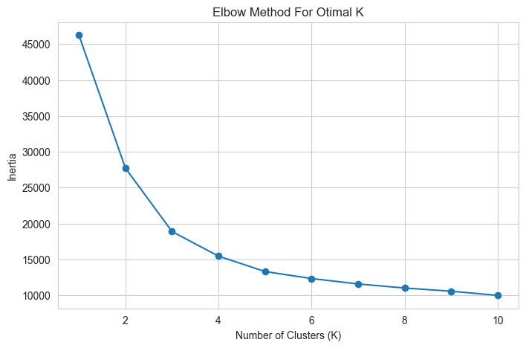
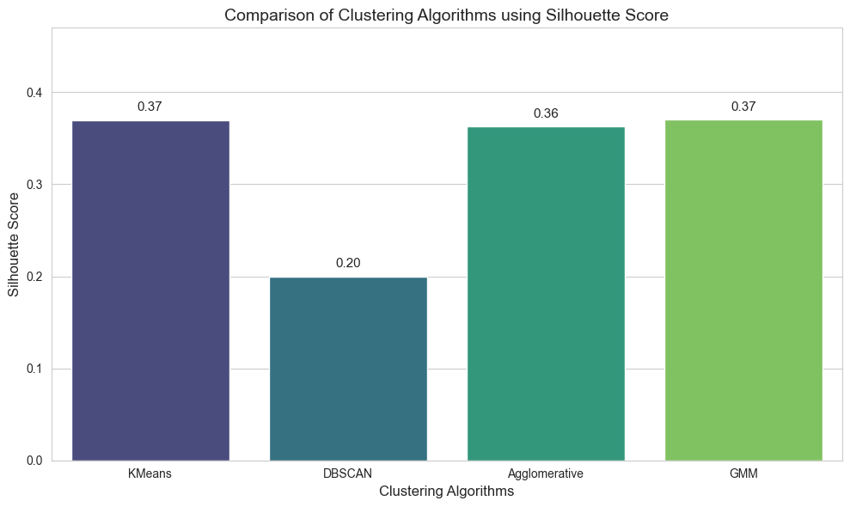
Model Selection Metrics
Elbow Curve & Silhouette Score
Elbow Curve — Optimal K
Silhouette Scores — Algorithm Comparison
Inertia drops sharply up to K=4 then flattens → K=4 selected
K-Means (0.37) & GMM (0.37) tied for best; DBSCAN lowest (0.20)
17 / 22

Slide 18
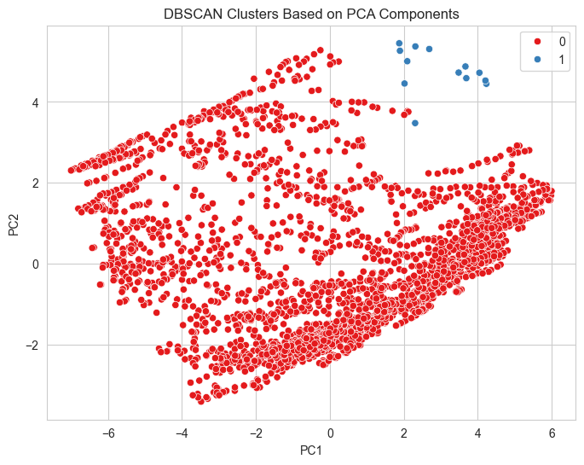
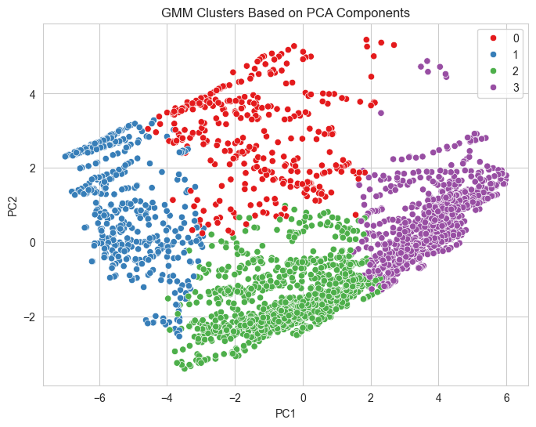
Cluster Visualisations
PCA-Based Scatter Plots for Each Algorithm
DBSCAN — 2 Clusters (PCA Space)
GMM — 4 Clusters (PCA Space)
Both plots use PC1 (x-axis) and PC2 (y-axis). GMM produces well-separated clusters across 4 groups; DBSCAN identifies 2 groups with noise.
18 / 22

Slide 19
Model Selection & Fitting
Final Model Evaluation & Selection
K-Means
Agglomerative
GMM
DBSCAN
0.37
0.36
0.37
0.20
Silhouette Score
Silhouette Score
Silhouette Score
Silhouette Score
Partitioning
Hierarchical
Model-Based
Density-Based
✅ Selected
✅ Selected
✅ Selected
⚡ Reference
Cluster Interpretation (K=4, Silhouette=0.37)
Cluster 0 → Underdeveloped Countries: High birth rate, high infant mortality, low GDP & internet usage
Cluster 1 → Developing Countries: Moderate indicators, improving health & connectivity metrics
Cluster 2 → Emerging Economies: Strong GDP growth, rising internet & mobile adoption
Cluster 3 → Developed Countries: High life expectancy, high internet usage, high health expenditure
19 / 22

Slide 20
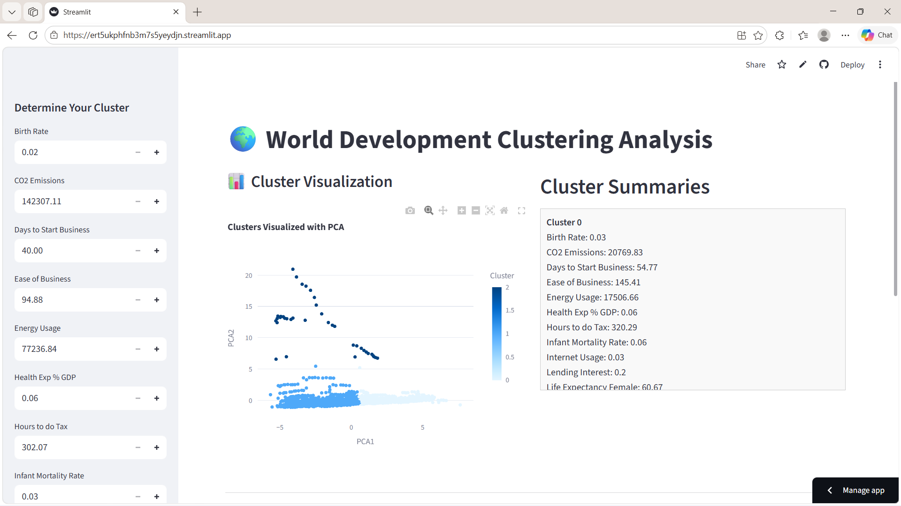
User Interface & Application Output
Streamlit Web Application Preview
🎛️ Input Panel
19 adjustable sliders for all economic & demographic indicators
🔮 Predict Button
Passes inputs to the selected ML model for real-time cluster prediction
📊 Results
Displays cluster label + development category instantly
Cluster Visualization
Displays cluster viualization with PCA
20 / 22

Slide 21
Deployment Details
Platform, Workflow & Live URL
Deployment Platform
Model Persistence
Prediction Workflow
Framework: Streamlit (Python-based)
Hosting: Streamlit Community Cloud
Access: Public URL — no login required
Models serialised using pickle / joblib
Saved: K-Means, DBSCAN, Agglomerative,
GMM Clustering models
Loaded on demand at inference time
1. User inputs 20 feature values via sliders
2. Inputs preprocessed (StandardScaler)
3. PCA transformation (→ 6 components)
4. Model predicts cluster label (0–3)
🚀 Live Application URL
Streamlit
Results Display
The deployed application classifies input country metrics into one of 4 clusters:
Cluster 0 → Underdeveloped | Cluster 1 → Developing | Cluster 2 → Emerging | Cluster 3 → Developed
Output includes cluster ID, development category label, and key metric comparisons.
21 / 22

Slide 22
Appendix
Thank You
▸ World Development Measurement Dataset (CSV)
▸ Correlation Matrix — Full 20×20
▸ StandardScaler — Full Scaled DataFrame
▸ PCA Scree Plot — Variance Explained
▸ Dendrogram — Agglomerative Clustering
▸ Fuzzy C-Means Membership Matrix
▸ Streamlit App Source Code (GitHub)
Global Development Index Analysis & Clustering
Mihir Nigam
22 Slides
5 Algorithms
K=4 Clusters
Streamlit Deployed

